Slide 1

Patent Bank
Our Digital Will is…

Slide 2
Table of contents
01
02
04
03
Our team
Our idea
Used Technologies
Stages of realizations

Slide 3
01
Our Team

Slide 4
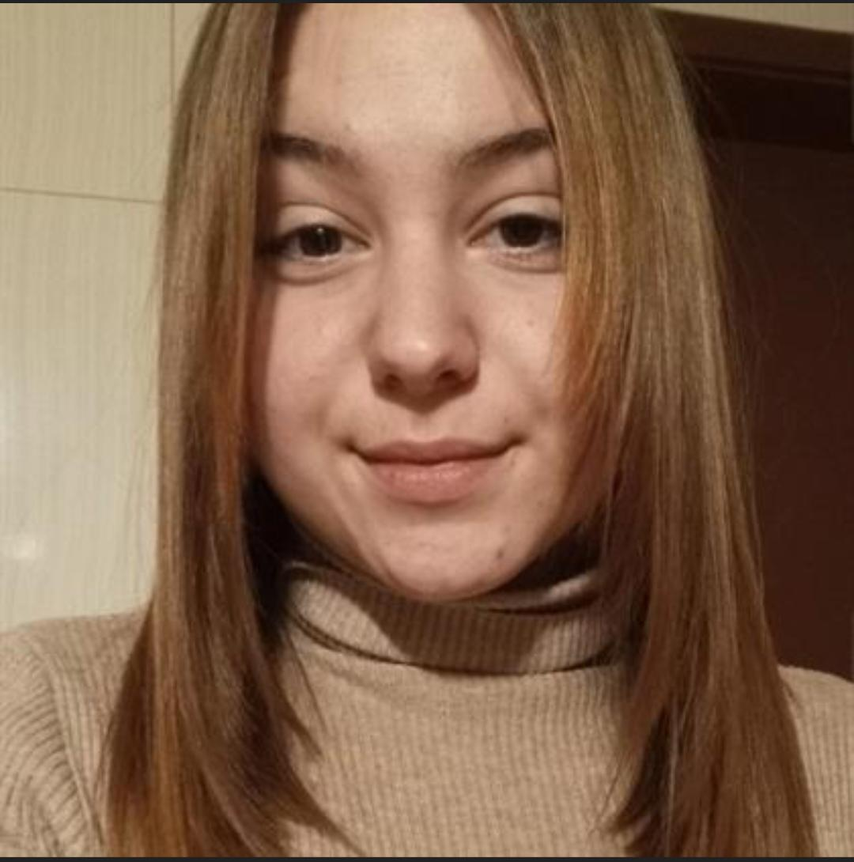
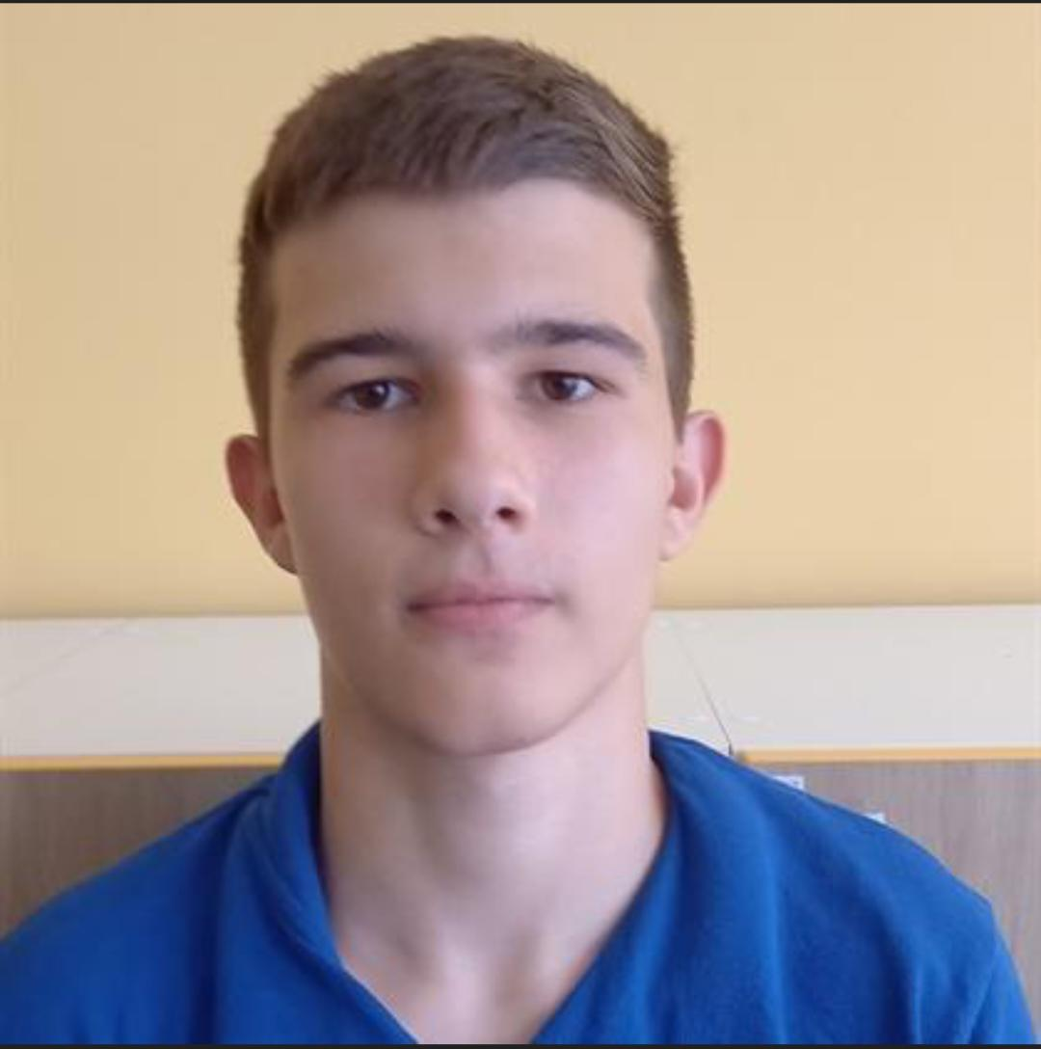
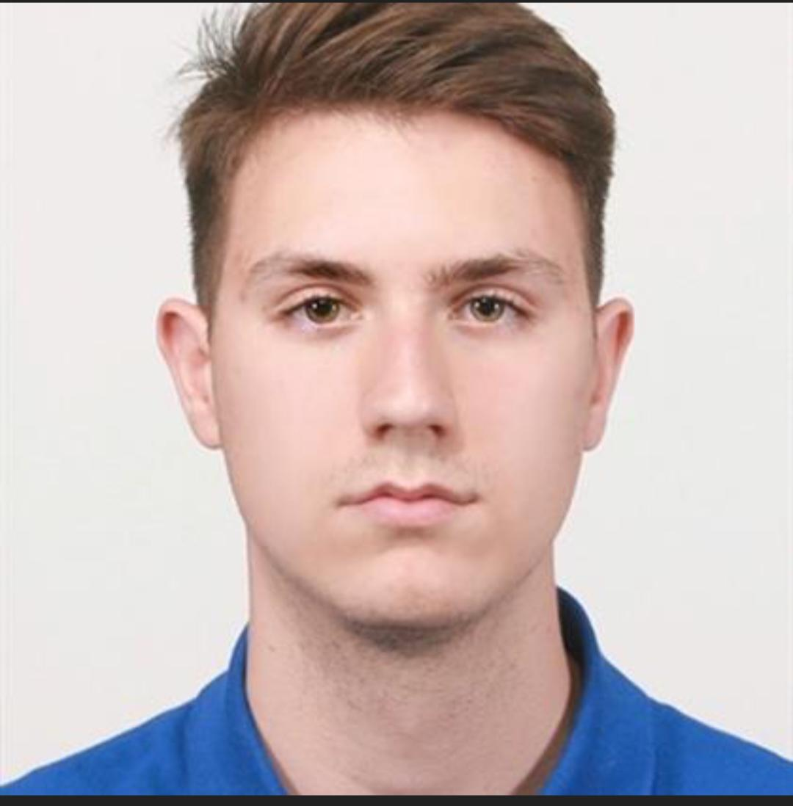
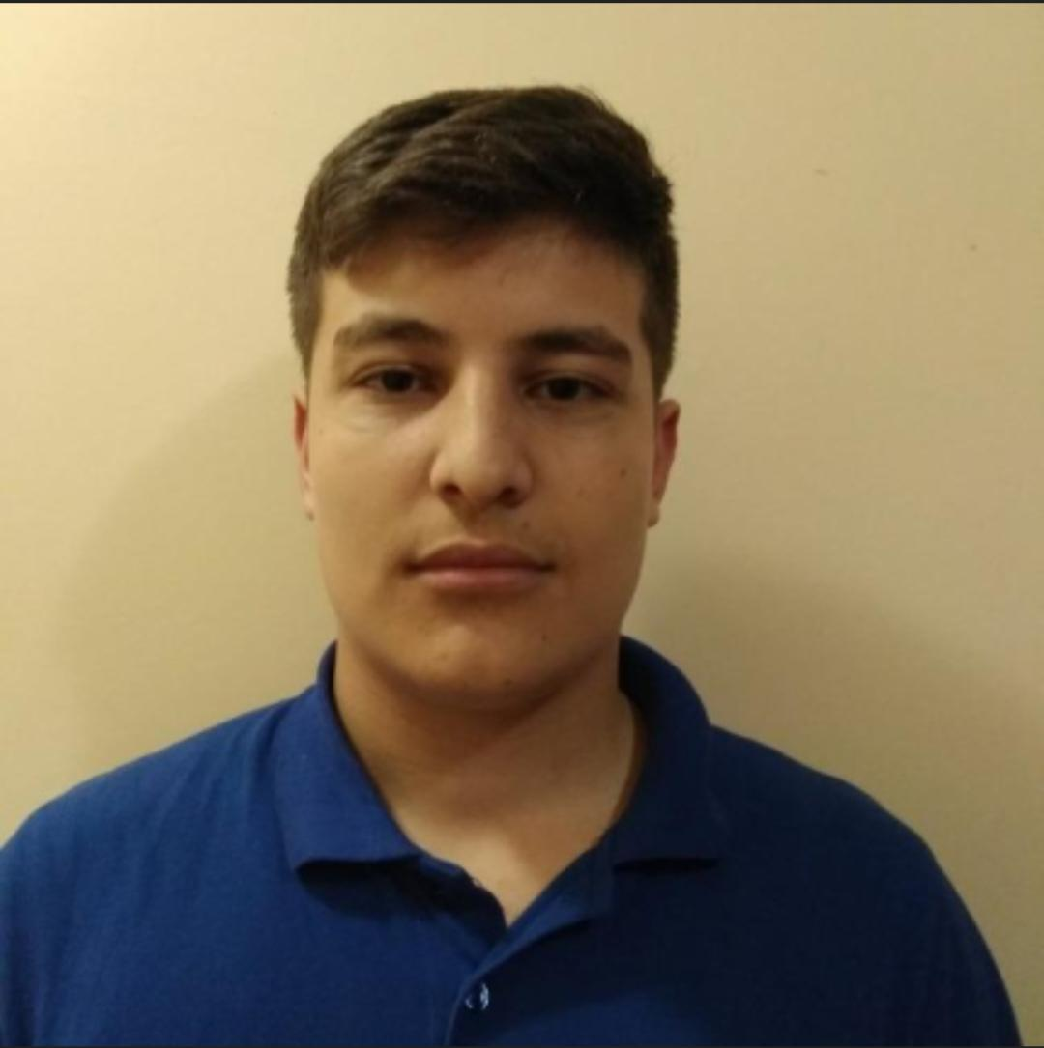
Jasmina Vulkova
Georgi
Filipov
Atanas Apostolov
QA and documentation
Backend developer
Scrum trainer
Ivailo Dandarinov
Frontend developer

Slide 5
02
Our Idea

Slide 6
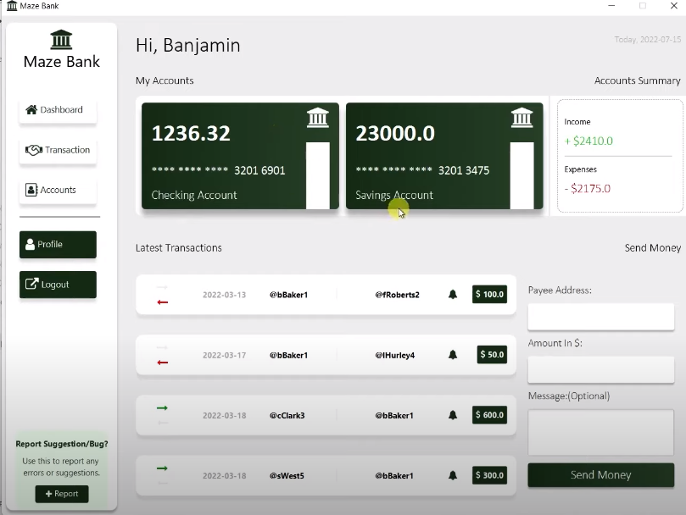
.
Our project is an application that helps manage people's finances (online bank ).

Slide 7
03
Stages of realization

Slide 8
01
02
03
04
Realization
Test
Present
Idea & organization

Slide 9
04
Used languages

Slide 10








Slide 11
Let’s jump into the game!

